Slide 1

Cross-validation
Data Analytics Department Bridgerland Technical College

Slide 2
Content
Cross-validation (CV)
Definition of Cross-validation
Types of cross-validation in machine learning
Difference between the train/test split method and cross-validation

Slide 3
Cross-validation: Definition
It is necessary to assure that our model gets the correct patterns from the data and that it is not getting too much noise. For that, we have the cross-validation technique.
Cross-validation is a technique where the main idea is to split the dataset into two parts: training and testing sets. We train the model using the training set and evaluate the model using the testing set.

Slide 4
Cross-validation: Definition
Using this technique,
we can detect data overfitting
we can validate the model efficiency by training the model on the subset input data and testing on the other unseen subset input data.
we tend to have a lower bias than other methods.
In general, this technique is easy to understand and implement.

Slide 5
Cross-validation: Definition
There are several techniques that uses cross-validation but all of them have similar algorithm as follows:
Divide the data into two sets: Training and testing sets.
Train the model on the training set
Validate the model on the testing set
Repeat the other steps according to the CV methods.

Slide 6
Cross-validation: Types
Common cross-validation methods:
Hold-out
K-folds
Leave-one-out
Leave-P-Out
Stratified K-folds
Repeated K-folds
Nested K-folds
Time series CV

Slide 7
Cross-validation: Types
We will discuss the first three of the list in this section:
Hold-out
K-folds
Leave-one-out

Slide 8
Cross-validation: Hold-out Method
Entire data is divided in two sets: Training and test set.
Data can be divided into the following options:
Training set: 50%; Test set: 50%
Training set: 60%; Test set: 40%
Training set: 70%; Test set: 30%
Training set: 75%; Test set: 25%
Training set: 80%; Test set: 20%
Rule: Training data must be larger than the test data.

Slide 9
Cross-validation: Hold-out Method
Advantages: This method is a non-exhaustive cross-validation technique. It is computationally inexpensive compared to the other cross-validation techniques.
Disadvantages: Since we can’t be sure which part of the data is the train or test set, we might end it up with a high variance and when we change the split, then the accuracy would change as well. This can lead us to overestimate the test error.

Slide 10
Cross-validation: K-Fold
Entire data is divided in k-sets of equal sizes.
We train and test the model in the following way:
The first set would be the test set and then we trained the model on the remaining “k-1”sets.
Then, the second set would be the test set and the remaining sets would be the training set and so on.
Then, we calculate the test error rate after fitting the model to the test data for each iteration.

Slide 11
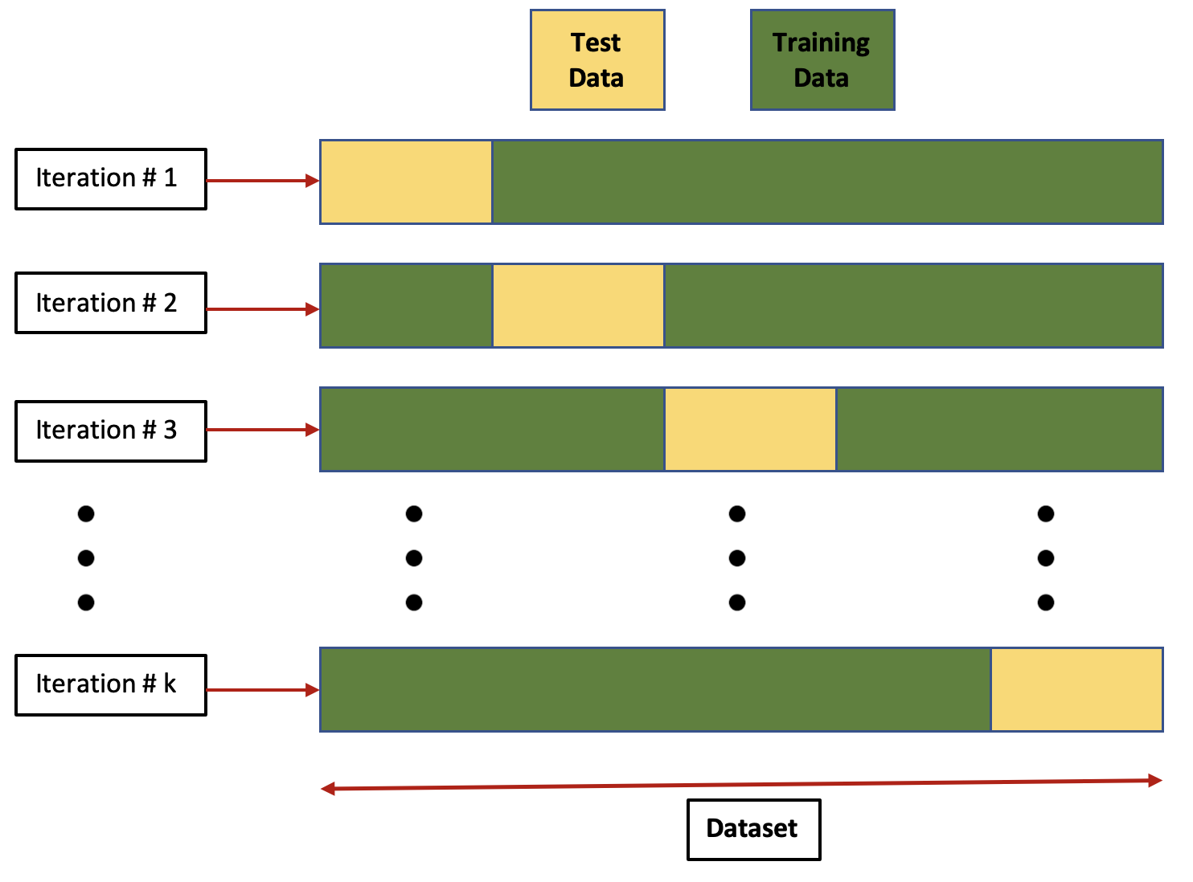
Cross-validation: K-Fold
Representation of the process for all the k sets:

Slide 12
Cross-validation: K-Fold
When we have all the test error rates from all the iterations (k-iterations), we calculate the mean of those errors as the cross-validation test error estimate.
Advantages: As the number of folds k increases, the variance decreases, which gives us low variance.
Disadvantages: It needs to run k-times, so it is computationally expensive.

Slide 13
Cross-validation: Leave-One-Out
Entire data is divided in training and test sets.
Let say that the dataset has N observations.

Slide 14
Cross-validation: Leave-One-Out
In this method, we select a SINGLE observation as test data and the rest (N-1) observations are part of the training set.
Then, we select another SINGLE observation as test data and the rest observations are part of the training set, and so on.
Then, we calculate the test error rate after fitting the model to the test data for each iteration (N-times).
We calculate the average of all the test error rates for all the iterations (N-Times) as the cross-validation test error estimate.

Slide 15
Cross-validation: Leave-One-Out (LOOCV)
Advantages: LOOCV gives unbiased estimates (low bias).
Disadvantages: Since we find the average of N-models, LOOCV has a very high variance. This is computationally expensive.

Slide 16
Difference between the train/test split method and cross-validation
Train/test split:
Input data divided into two parts: Training and test set.
Ratio can be 70% training and 30% test set or 80% training and 20% test set.
The disadvantage here is that this method gives a high variance.
Cross-validation:
This method is used to overcome the disadvantage of the Train/test split.
Splitting the dataset into groups and averaging the result makes the method more efficient compared to Train/test split.

Slide 17

Reference
Cross-validation in ML: https://www.geeksforgeeks.org/cross-validation-machine-learning/

Slide 18

Questions?

